Slide 1


Stay Safe
By
Gagan Bhatia

Slide 2
85% of all American women experienced sexual harassment in the workplace in 2019

Slide 3
Only 25% of women who were victims of sexual harassment at work statistics say they could easily report the incident to their employers.

Slide 4
Why are the reporting numbers so less?
Intimidation is a key factor here as most individuals state this is the number one reason why some cases are not taken into account or acted upon.
Fear reprisal or retaliation from the harasser, colleagues or their employer.
Victims do not disclose sexual violence because they are embarrassed or do not want anyone to know

Slide 5
How to make it more safe to report and prevent crime?
Presenting StaySafe!

Slide 6
StaySafe
StaySafe makes the process of reporting a harassment simple and efficient
StaySafe Allows the authorities to have multiple check-ins with the person and prevent any further crimes
StaySafe makes the process discreet and immediate help can be called and action can be taken

Slide 7
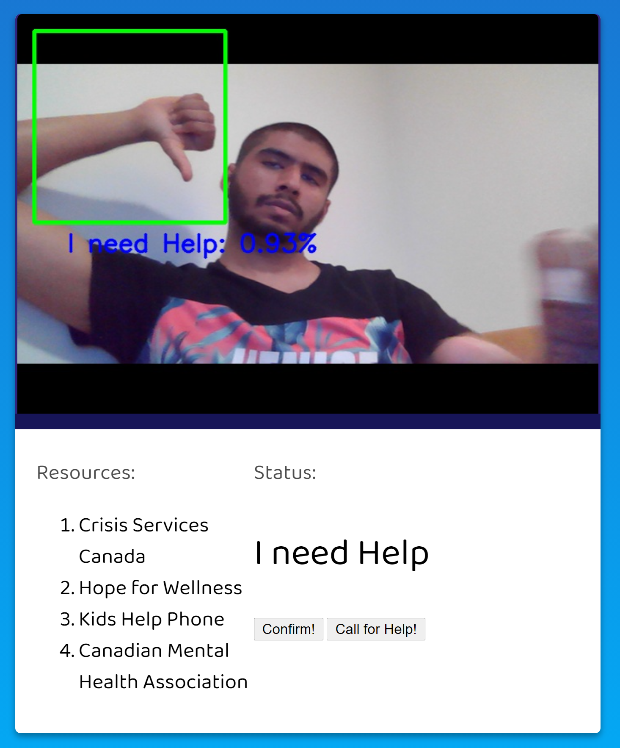
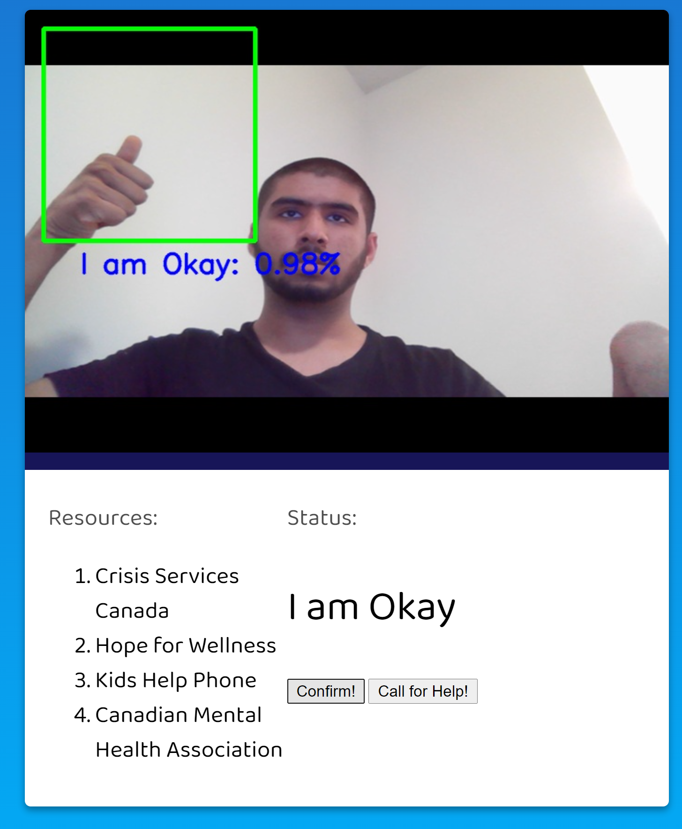
StaySafe UI

